Slide 1

PBL presentation for Skills and Competency Evaluation(SCE) Microcontroller And Applications (ETUA22202)(SY ETC SEM-II AY 23-24 )
PBL TITLE
Div.:- B
By: Group No. –
Roll No. | G.R. No. | Name of Student | Contact number
212009 | 22210640 | Rohit Chauhan | 7218583261
212005 | 22210425 | Gaurav Bhaltilak | 8956046920
212017 | 22210275 | Prasad Gangurde | 7385138969
Name of instructor: Dr. Rahul S. Pol
Department of Electronics and Telecommunication Engineering
BRACT’S, Vishwakarma Institute of Information Technology, Pune-48
(An Autonomous Institute affiliated to Savitribai Phule Pune University) (NBA and NAAC accredited, ISO 9001:2015 certified)
1

Slide 2
OUTLINE
AIM
OBJECTIVES
HARDWARE MATERIALS ARE REQUIRED AND SPECIFICATIONS
DESIGN (BLOCK DIAGRAM)
INTERFACING DIAGRAM ON PROTEUS
WORKING DESCRIPTION
ALGORITHM/FLOWCHART
PROGRAM IMPLEMENTATION
HARDWARE IMPLEMENTATION
RESULTS AND CONCLUSION
REFERENCES
12. TITLE OF PAPER IMPLEMENTED USING PBL
Department of Electronics and Telecommunication Engineering, VIIT, Pune-48
2

Slide 3
AIM
The aim of a bidirectional visitor counter using an 8051 microcontroller is to count the number of people entering and exiting a specific area or premises. This system utilizes sensors to detect the entry and exit of individuals and then updates the count accordingly. The 8051 microcontroller is programmed to increment or decrement the count based on the signals received from the sensors. a bidirectional visitor counter using an 8051 microcontroller can provide valuable insights into visitor patterns, helping facility managers make informed decisions regarding resource allocation, crowd management, and facility optimization. This type of system is commonly used in various settings such as malls, libraries, museums, and other public venues to monitor visitor traffic.

Slide 4
OBJECTIVES
Accurate Counting: The system should reliably count each instance of a person entering or exiting the monitored area, ensuring precision in the tally.
Bidirectional Tracking: It should differentiate between entries and exits to maintain an accurate count regardless of the direction of movement.
Real-time Updates: The counter should update in real-time to provide up-to-date information about the current number of people inside the premises.
User-friendly Interface: Incorporating a user interface, such as an LCD display or LED indicators, to present the count in a clear and understandable format for users or administrators.
Integration with Sensors: Utilizing appropriate sensors, such as infrared or motion sensors, to detect the presence of individuals entering or leaving the area.
Low Power Consumption: Optimizing the design to ensure minimal power consumption, especially in scenarios where the system operates continuously.
Robustness and Reliability: Ensuring the system's stability and resilience to environmental factors or interference, thereby minimizing errors in counting.
Cost-effectiveness: Designing the system with affordable components and minimal complexity to keep the overall cost low.

Slide 5
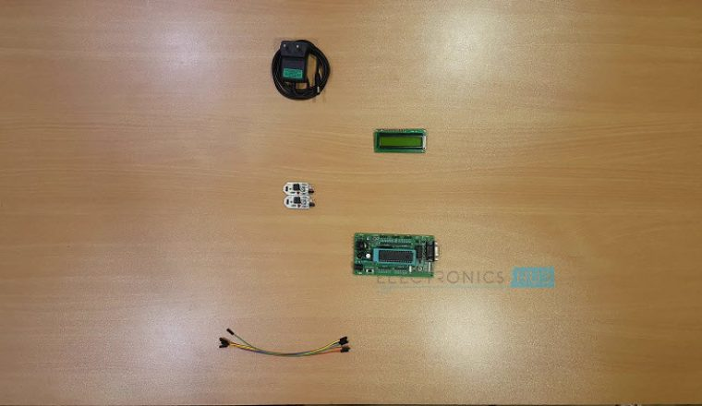
HARDWARE MATERIAL REQUIRED AND SPECIFICATIONS
AT89C51 (8051 based Microcontroller)
8051 Programmer
Push Button
10µF Electrolytic Capacitor
2 x 10KΩ Resistors (1/4 Watt)
11.0592 MHz Crystal
2 x 33pF Ceramic Capacitors
16 x 2 LCD Display
10KΩ Potentiometer
2 x IR Sensors (Reflective Type)
Connecting Wires
Power Supply
Keil µVision Software
Proteus

Slide 6
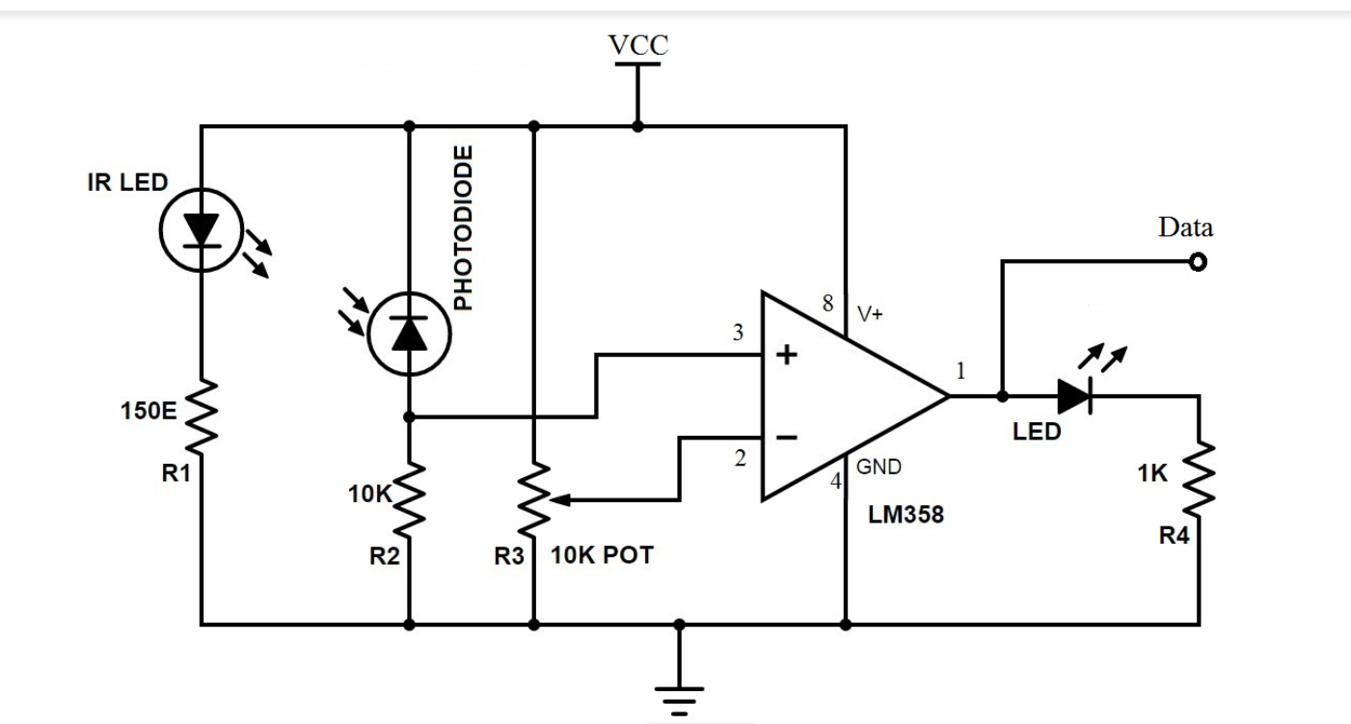
DESIGN (BLOCK DIAGRAM)

Slide 7
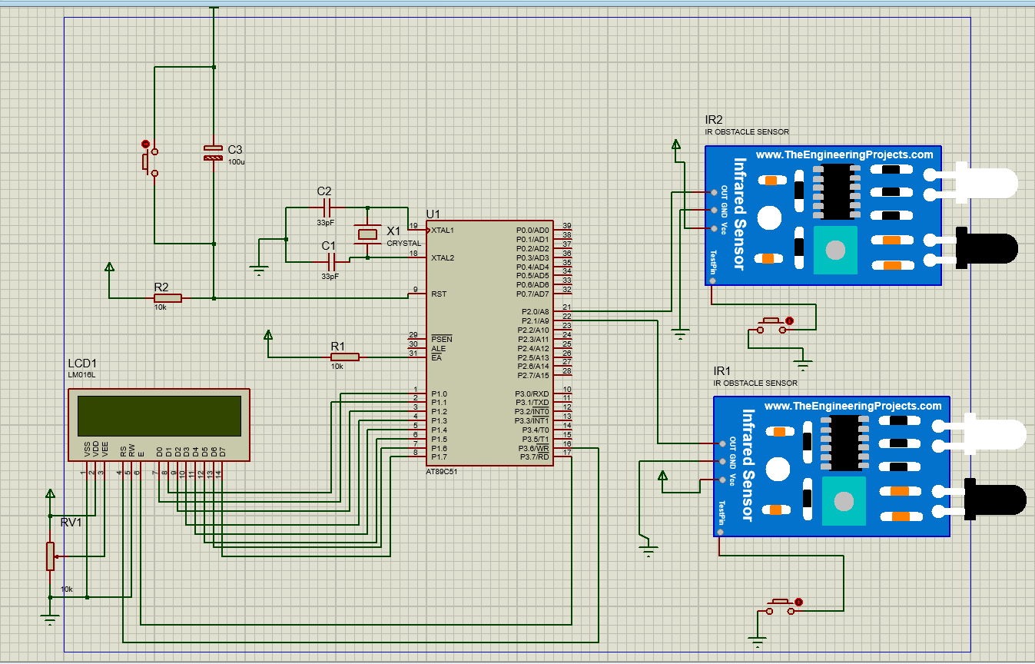
INTERFACING DIAGRAM ON PROTEUS

Slide 8
WORKING DESCRIPTION
1-When the system is powered ON, the microcontroller initially initializes the stack pointer and all other variables. It then scans the input pins (P2.0 and P2.1).
In the meantime, when there is no object in front of the IR Sensors, the light from the IR LED would not fall on the Photo Diode of the first sensor pair and hence, the Photo Diode doesn’t conduct.
2-As a result, the output of the IR sensors is LOW. In other words, ports P2.0 and P2.1 are at logic LOW level. If there is a person in front of the IR Sensors, IR light from the IR LED reflects from the person and falls on the Photo Diode.
3-As a result, the Photo Diode starts conducting and the output of the sensor becomes HIGH. In other words, the ports P2.0 and P2.1 are at logic HIGH level.
4-Now when a transition takes place, i.e. a logic HIGH level is received, first at port P2.0 and then at P2.1, the microcontroller sees this as an interruption to sense the passage or entry of a person or an object in front of the IR LED and the Photo Diode.
s per the program, the count value is increased and this value is displayed on the 16 x 2 LCD Display.
5-if the microcontroller senses logic HIGH, first on the P2.1 and then on P2.0, it assumes that the person is leaving the room and as per the program, the microcontroller decreases the count as displays the same on the LCD.
6-The program ensures that the count is increased or decreased only when both the sensors detect the person.

Slide 9
ALGORITHM/FLOWCHART
Step 1: Initialization
Set the microcontroller to initialize the counter to zero.
Set the IR sensors to detect the presence of visitors.
Step 2: Detect Visitor Entry
When a visitor enters the room, the IR sensor detects the change in the IR signal and sends a signal to the microcontroller.
The microcontroller increments the counter by one.
Step 3: Detect Visitor Exit
When a visitor exits the room, the IR sensor detects the change in the IR signal and sends a signal to the microcontroller.
The microcontroller decrements the counter by one.
Step 4: Display Counter Value
The microcontroller sends the counter value to the 7-segment displays, which display the count.
Step 5: Repeat
Steps 2-4 are repeated continuously until the system is powered off.

Slide 10
ALGORITHM/FLOWCHART
The flowchart for this algorithm can be represented as follows:
-Start
Initialize counter to zero
Initialize IR sensors
-Loop
Detect visitor entry
Increment counter
-Detect visitor exit
Decrement counter
-Display counter value
-End

Slide 11
ALGORITHM/FLOWCHART
…..

Slide 12
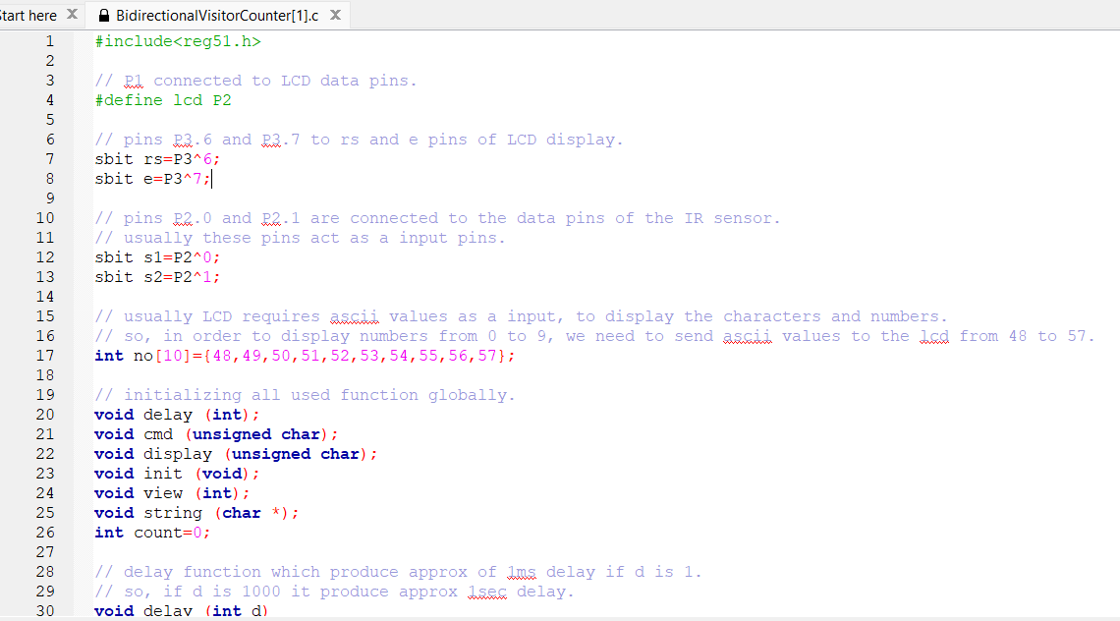
PROGRAM IMPLEMENTATION

Slide 13
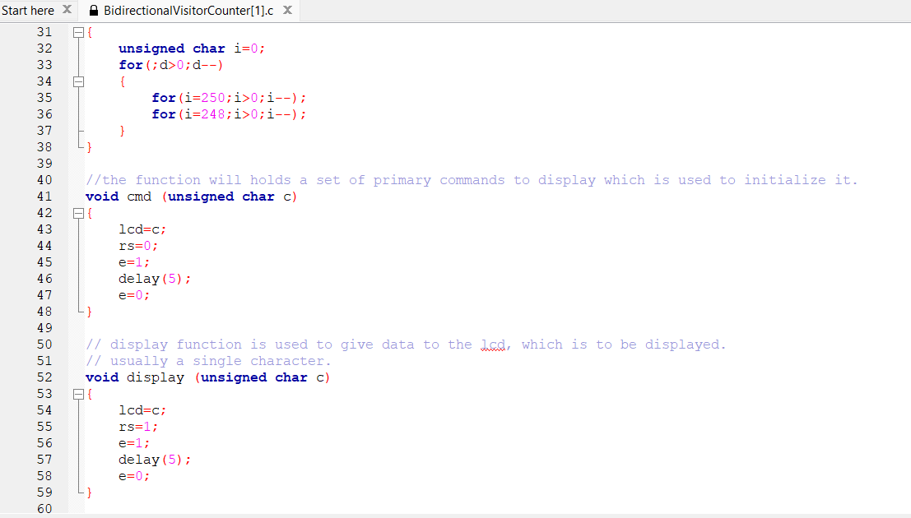
PROGRAM IMPLEMENTATION

Slide 14
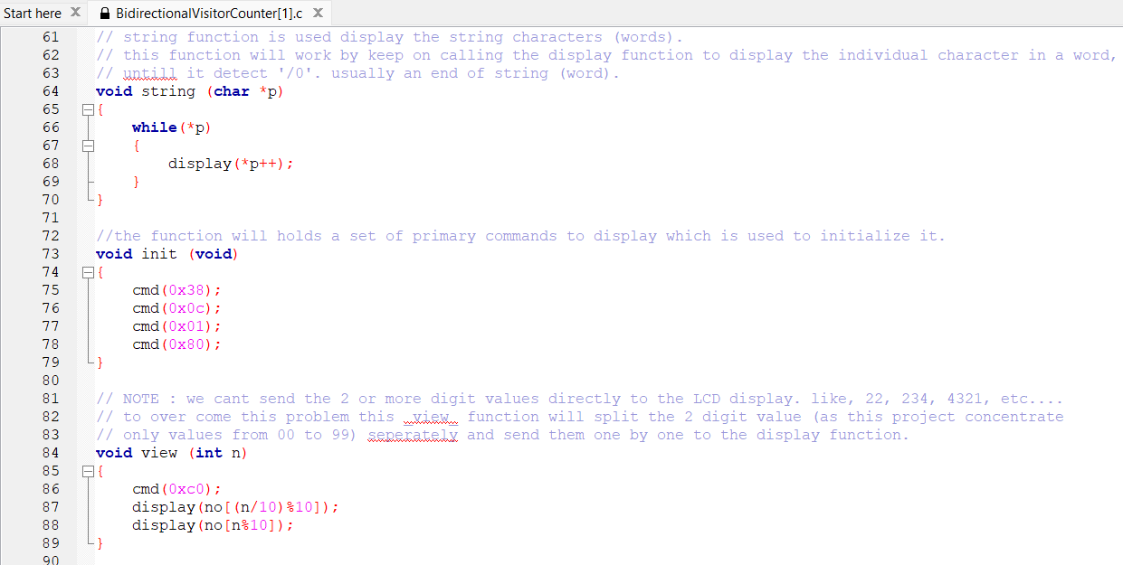
PROGRAM IMPLEMENTATION

Slide 15
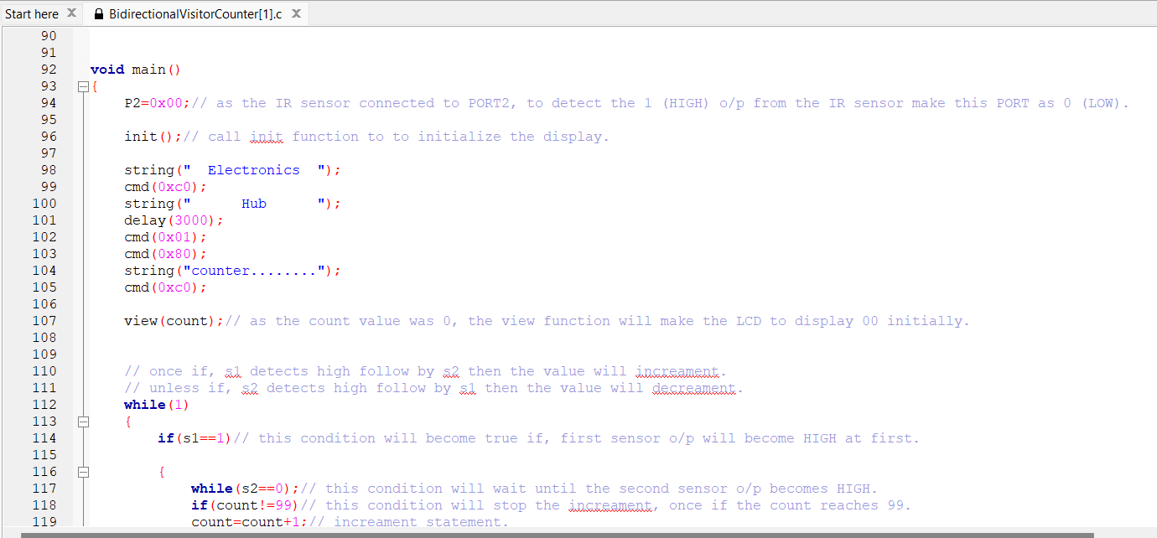
PROGRAM IMPLEMENTATION

Slide 16
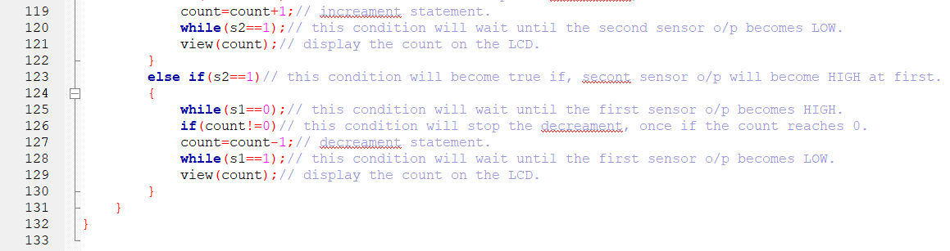
PROGRAM IMPLEMENTATION

Slide 17
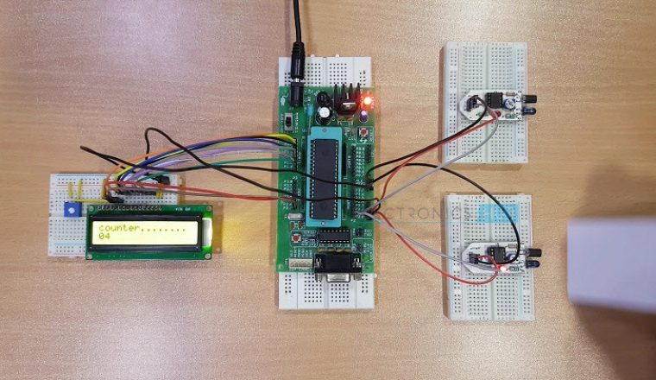
HARDWARE IMPLEMETATION
.

Slide 18
RESULTS AND CONCLUSION
Result:
Accuracy: The visitor counter accurately tracks the number of people entering and exiting the monitored area.
Real-time Updates: The counter provides real-time updates of the current visitor count.
Bidirectional Counting: The system effectively counts both entry and exit events separately.
User Interface: The user interface displays the visitor count in a clear and understandable format.
Integration with Sensors: The system interfaces seamlessly with sensors to detect entry and exit events.
Robustness: The system demonstrates stability and reliability in operation, with minimal errors or interruptions.
Low Power Consumption: The design optimizes power consumption, ensuring efficient operation over extended periods.

Slide 19
RESULTS AND CONCLUSION
Conclusion:
The bidirectional visitor counter using an 8051 microcontroller has successfully achieved its objectives of accurately tracking visitor traffic in both directions. By implementing interrupts and sensor interfaces, the system provides real-time updates of the visitor count, enabling facility managers to monitor occupancy levels effectively.
The user-friendly interface enhances accessibility and usability, while the system's robustness ensures reliable operation in various environments. Furthermore, the counter's low power consumption makes it suitable for continuous deployment without significant energy costs.
In conclusion, the bidirectional visitor counter represents an effective solution for monitoring visitor flow in public spaces, contributing to better resource management and improved crowd control. With further optimization and customization, it can be tailored to specific application requirements and deployed in a wide range of settings to enhance efficiency and convenience.

Slide 20
REFERENCES
-https://www.electronicshub.org/bidirectional-visitor-counter-using-8051-microcontroller/

Slide 21
TITLE OF PAPER IMPLEMENTED USING PBL
…..

